Slide 1
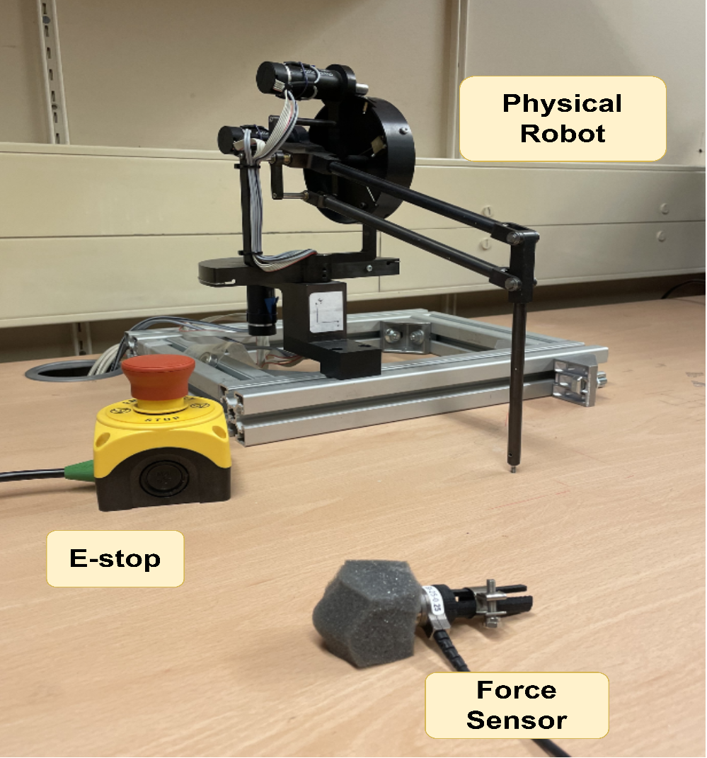
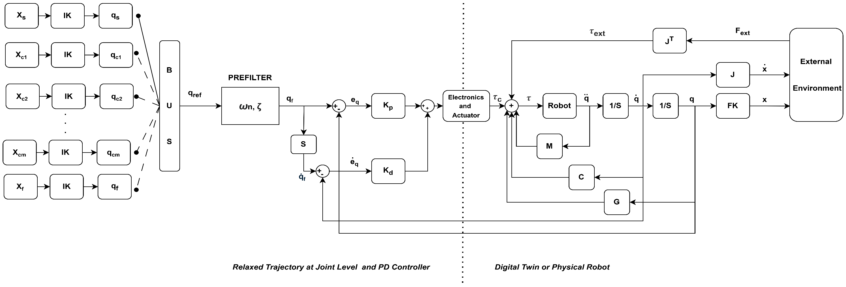
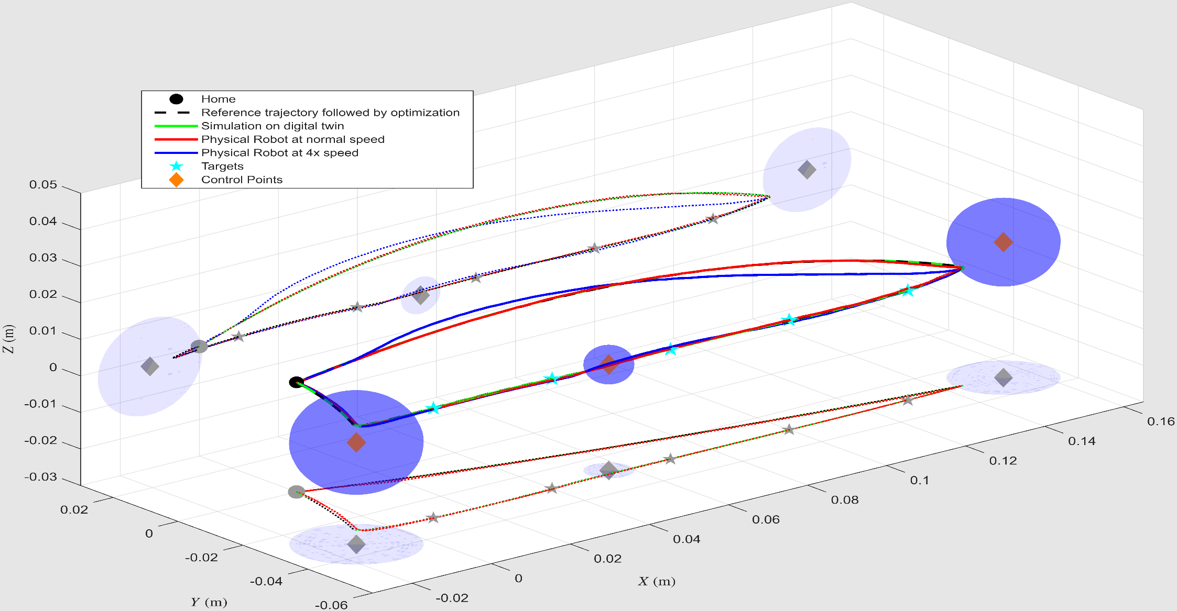
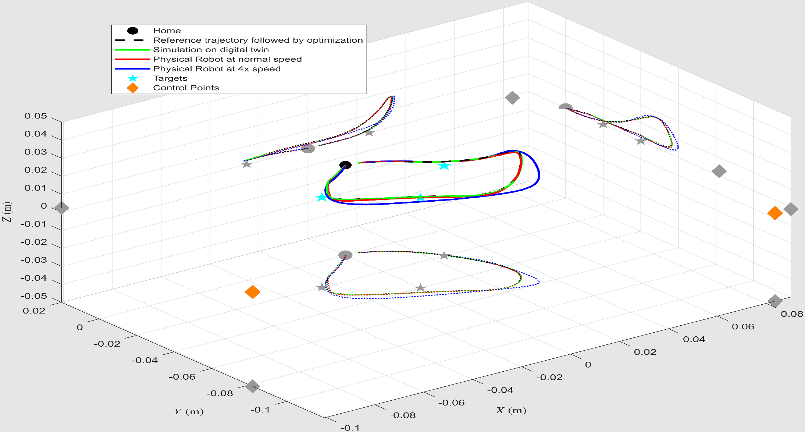
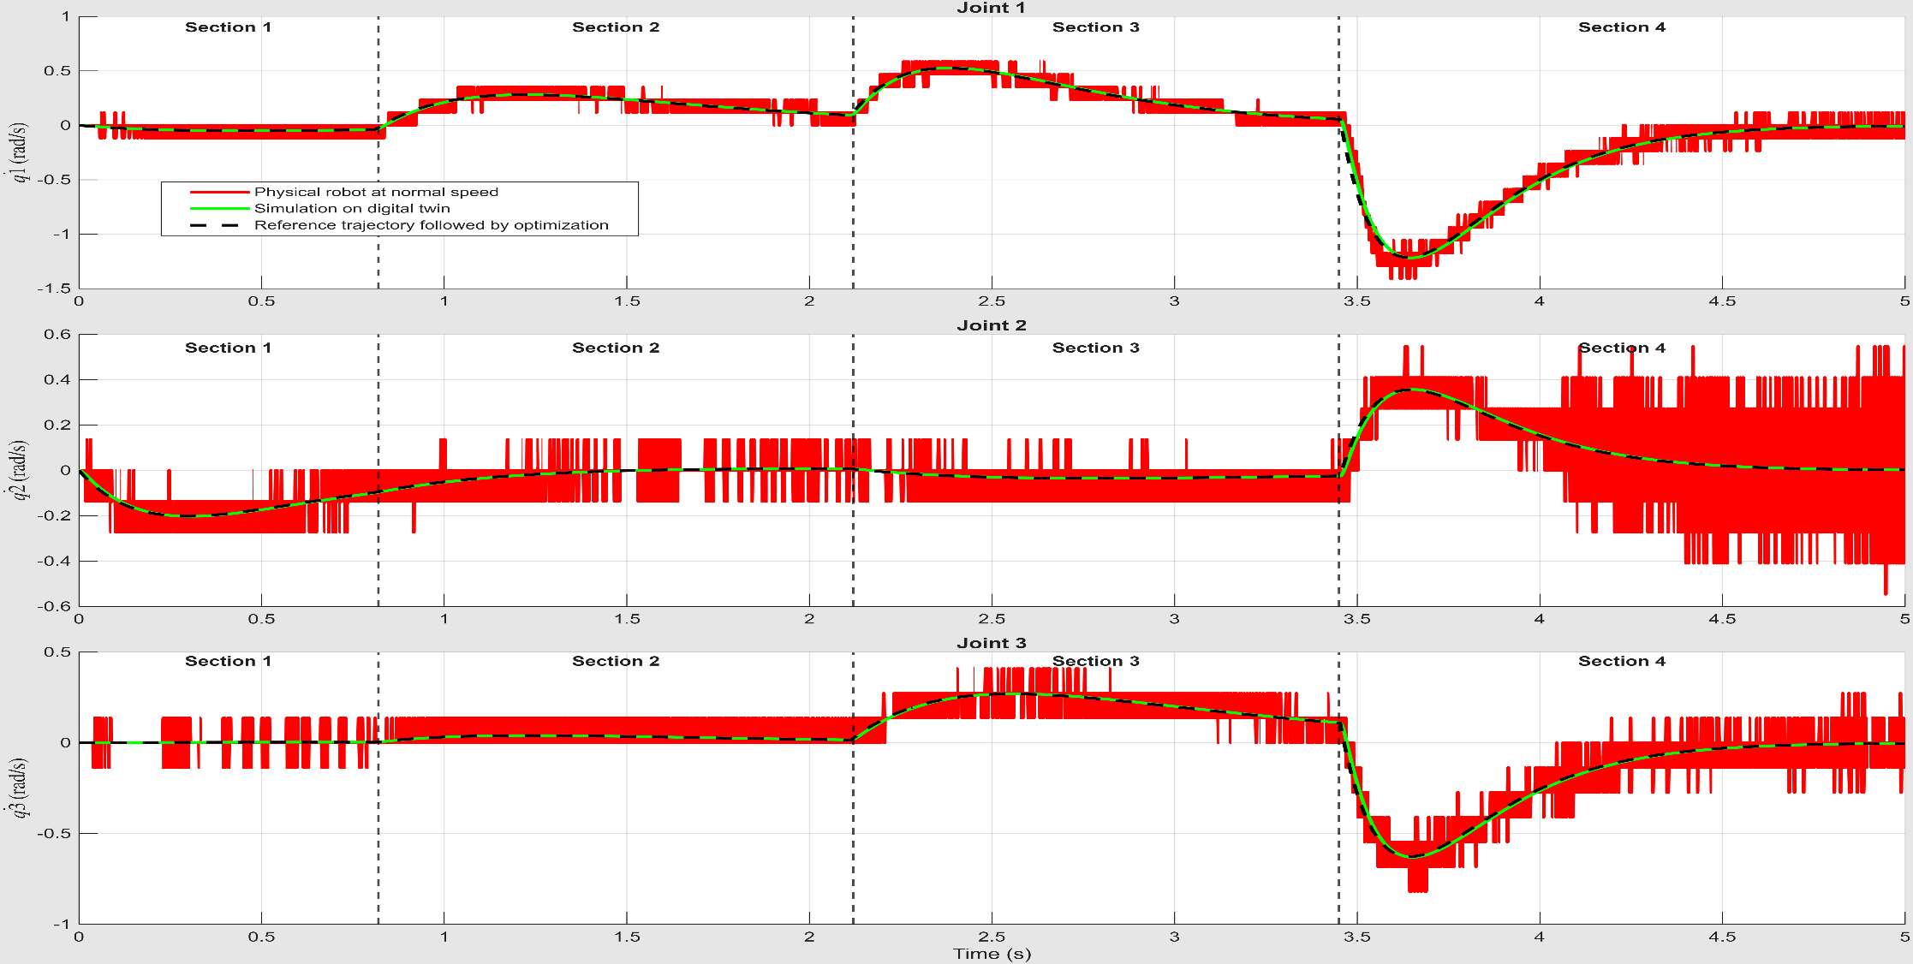
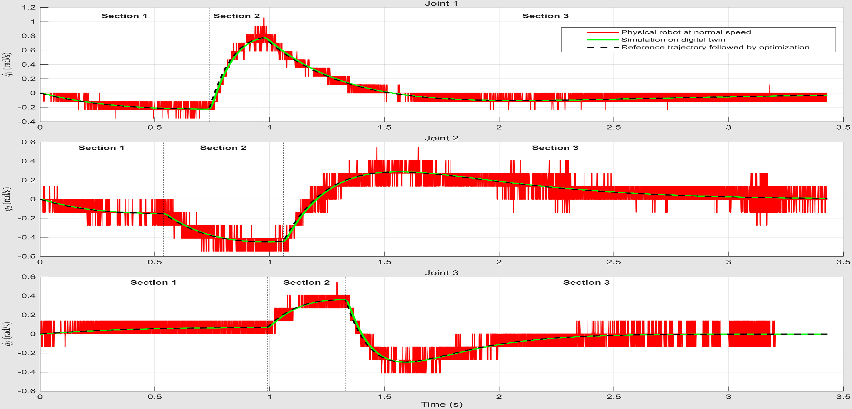
Dynamically Aware Robot Trajectory Generation and Optimisation
Koray Can YIGIT | Ozan TOKATLI | William HARWIN
Introduction
Methods and Advantages
Trajectory generation is critical to robotic motion planning, yet conventional kinematic methods often ignore robot dynamics, actuator limits, and controller effects, leading to trajectories that are infeasible in practice.
This work proposes a dynamics-aware relaxed trajectory optimization framework that explicitly incorporates robot dynamics, actuator constraints, prefilter, and PD control into trajectory generation. The method simultaneously optimizes and deforms trajectories to ensure dynamic feasibility while enabling controlled trajectory ‘speed-up’ .
Method uses control points to shape the trajectory and target points to compute the robots adherence to that trajectory.
The proposed relaxed trajectory method embeds the robot’s full closed-loop dynamics directly into the trajectory generation process.
The proposed relaxed trajectory method embeds the robot’s full closed-loop dynamics directly into the trajectory generation process.
Trajectory generation is performed using either hypersphere state switching or maximum-velocity switching, which regulate state transitions in joint space while preserving Cartesian path constraints
The advantages:
  fewer control points,
  efficient computation,
  continuity of position and velocity,
  simple speed adaption while preserving nominal path shape,
  implicit robot dynamics.
Figure 1: Physical Robot (Note force sensor not used in these experiments)
Figure 2: Block diagram of the system of hypersphere state switching and maximum velocity switching
Hypersphere State Switching Method
Maximum Velocity Switching Method
Cartesian Space Trajectories
Cartesian Space Trajectories
Figure 3: Reference, simulation and physical trajectories( at normal and 4x speed), including the home position, target position, control points and the associated sphere.
Figure 5: Reference, simulation and physical trajectories( at normal and 4x speed), including the home position, target position, control points and the associated sphere.
Minimum Distance Table
Minimum Distance Table
 | Target 1 | Target 2 | Target 3 | Target 4 | Target 5
Reference Trajectory | 0.13 mm | 0.03 mm | 0.2 mm | 0.12 mm | 0.24 mm
Simulation on digital twin | 0.03 mm | 0.1 mm | 0.15 mm | 0.19 mm | 0.14 mm
Physical Robot at normal speed | 0.16 mm | 0.36 mm | 0.15 mm | 0.16 mm | 0.53 mm
Physical Robot at 4x speed | 0.23 mm | 0.47 mm | 0.66 mm | 0.6 mm | 0.13 mm
 | Target 1 | Target 2 | Target 3
Reference Trajectory | 2.98 mm | 5.11 mm | 1.97 mm
Simulation on digital twin | 3.08 mm | 5.20 mm | 2.01 mm
Physical Robot at normal speed | 3.17 mm | 5.16 mm | 1.94 mm
Physical Robot at 4x speed | 2.68 mm | 7.89 mm | 1.99 mm
Table 1: Minimum distances between trajectories and targets
Table 2: Minimum distances between trajectories and targets
Joint Velocities
Joint Velocities
Figure 4: Shows the joint velocities following optimization for the reference, simulation and physical robot (x1). The observed variations result from changes in the section switching and prefilter parameters.
Figure 6: Shows the joint velocities following optimization for the reference, simulation and physical robot (x1). The observed variations result from changes in the section switching and prefilter parameters.
Conclusion
Experimental results show a significant improvement in trajectory adaptability, motion smoothness, while exploiting intrinsic dynamic properties of the robot and maintaining stable performance in unstructured environments.

